Slide 1
Chapter 6: Energy Efficiency
Energy is a bit like money: If you have a positive balance, you can distribute it in various ways, but according to the classical laws that were believed at the beginning of the century, you weren’t allowed to be overdrawn. —Stephen Hawking

Slide 2
Chapter Outline
What is Energy Efficiency?
Energy Efficiency General Scenario
Tactics for Energy Efficiency
Tactics-Based Questionnaire for Energy Efficiency
Patterns for Energy Efficiency
Summary

Slide 3
What is Energy Efficiency?
Energy used by computers used to be free and unlimited—or at least that’s how we behaved. Architects rarely worried about energy consumption of software in the past.
But with the dominance of mobile devices, the increasing adoption of the IoT, and the ubiquity of cloud services, energy has become an issue that architects can no longer ignore.
The consumption of energy can be managed by the architect, as with any other QA.

Slide 4
Energy Efficiency Concerns
An architectural approach is necessary to gain control over any important system quality attribute, and energy efficiency is no different. If system-wide techniques for monitoring and managing energy are lacking, then developers are left to invent them on their own.
Most architects and developers are unaware of energy efficiency as a QA of concern, and hence do not know how to go about engineering and coding for it.
Most architects and developers lack suitable design concepts—models, patterns, tactics, and so forth—for designing for energy efficiency, as well as managing and monitoring it at runtime.

Slide 5
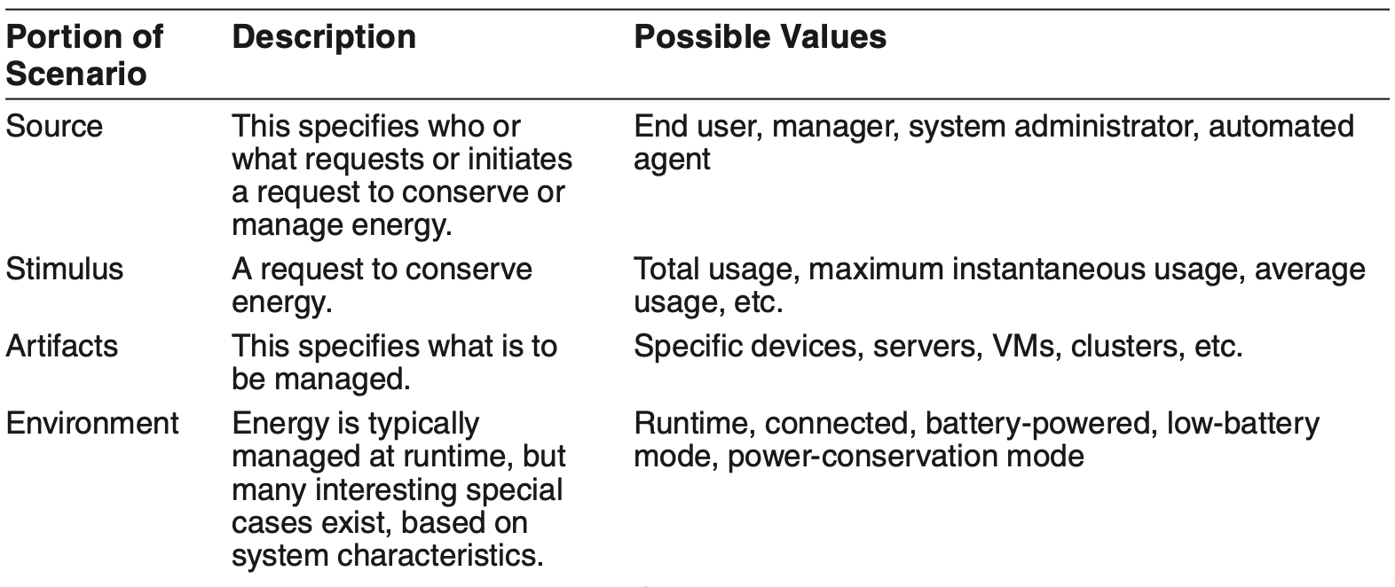
Energy Efficiency General Scenario

Slide 6
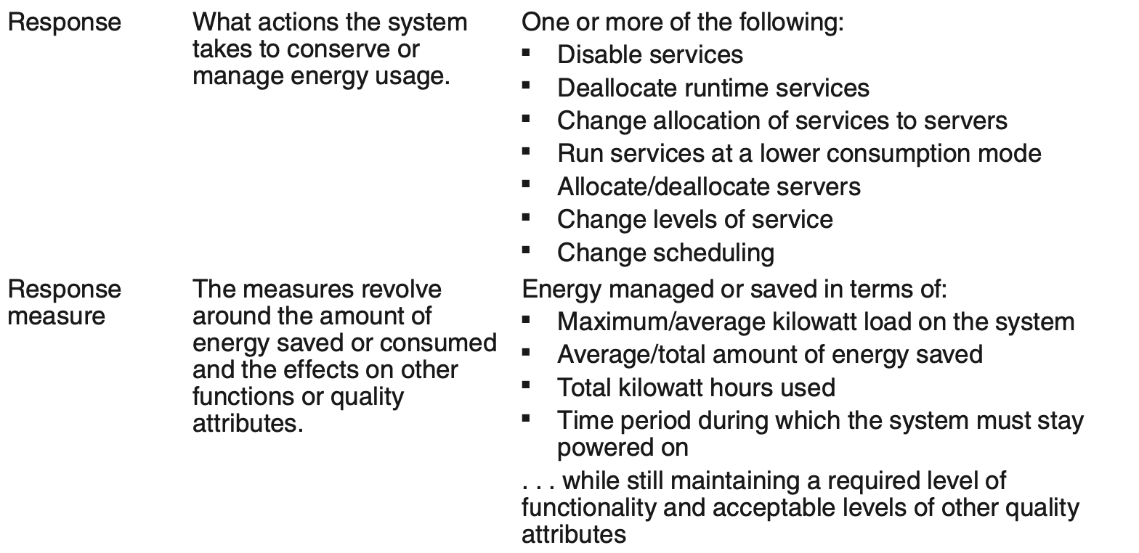
Energy Efficiency General Scenario

Slide 7
Sample Concrete Energy Efficiency Scenario
A manager wants to save energy at runtime by deallocating unused resources at non-peak periods. The system deallocates resources while maintaining worst-case latency of 2 seconds on database queries, saving on average 50 percent of the total energy required.

Slide 8
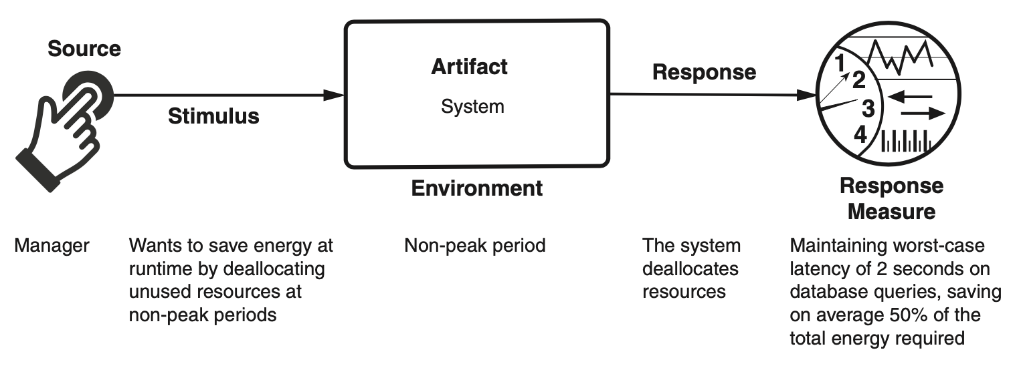
Sample Concrete Energy Efficiency Scenario

Slide 9
Goal of Energy Efficiency Tactics
An energy efficiency scenario is catalyzed by the desire to conserve or manage energy while still providing the required functionality.
This scenario is successful if the energy responses are achieved within acceptable time, cost, and quality constraints.

Slide 10
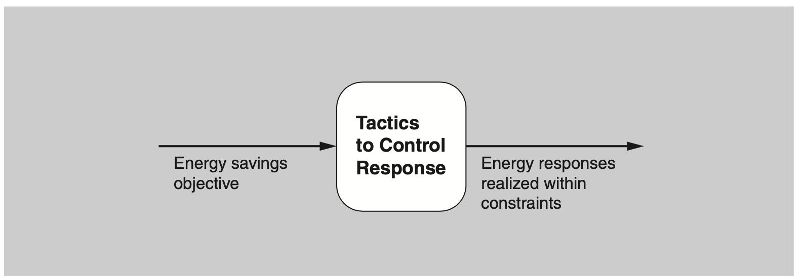
Goal of Energy Efficiency Tactics

Slide 11
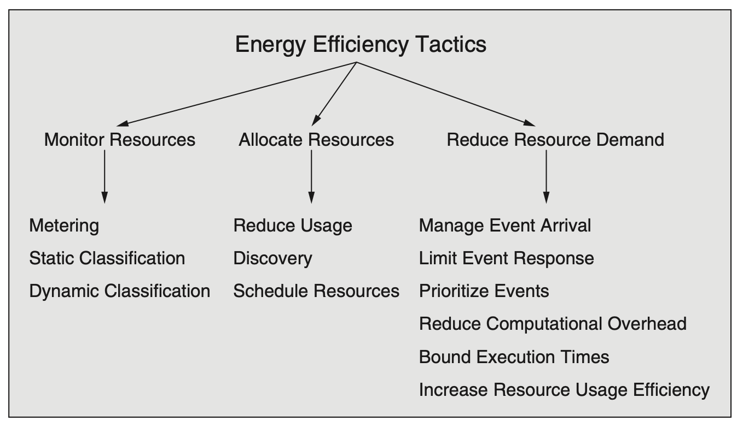
Energy Efficiency Tactics

Slide 12
Monitor Resources
Metering. The metering tactic involves collecting data about the energy consumption of computational resources via a sensor infrastructure, in near real time.
Static classification. Sometimes real-time data collection is infeasible. Static classification allows us to estimate energy consumption by cataloging the computing resources used and their known energy characteristics. These characteristics are available as benchmarks, or from manufacturers’ specifications.
Dynamic classification. In cases where a static model of a computational resource is inadequate, a dynamic model might be required. Unlike static models, dynamic models estimate energy consumption based on knowledge of transient conditions such as workload.

Slide 13
Allocate Resources
Reduce usage. Usage can be reduced at the device level by device-specific activities such as reducing the refresh rate of a display or darkening the background. Removing or deactivating resources when demands no longer require them is another method for decreasing energy consumption.
Discovery. As we will see in our discussion of Integrability (Chapter 7), a discovery service matches service requests with service providers. In the context of energy efficiency, this request could be annotated with energy information, allowing the requestor to choose a service provider based on its energy characteristics.
Schedule resources. Scheduling is the allocation of tasks to computational resources. As we will see in our discussion of Performance (Chapter 9), the schedule resources tactic can increase performance. For energy, it can be used to manage energy usage, given task constraints and respecting task priorities.

Slide 14
Reduce Resource Demand
This category of tactics is taken from the tactics characterization of Performance (Chapter 9).

Slide 15
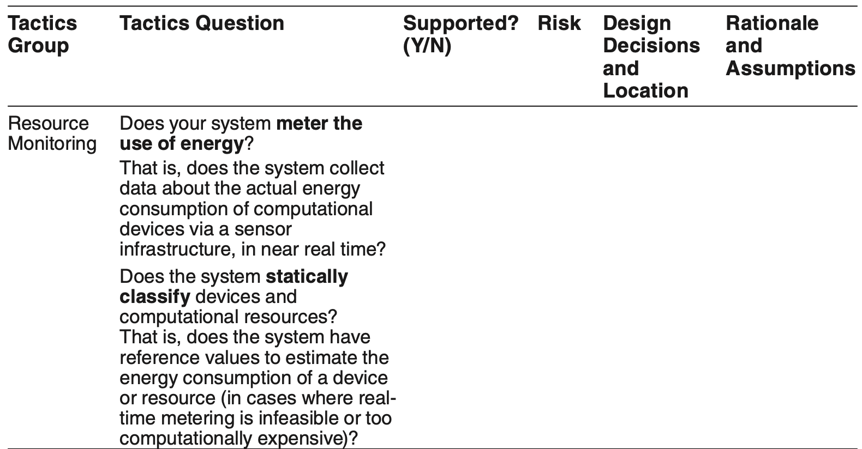
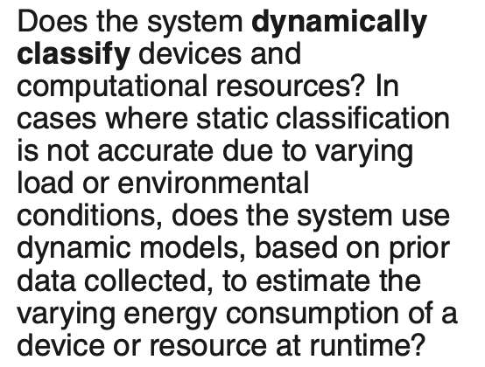
Tactics-Based Questionnaire for Energy Efficiency

Slide 16
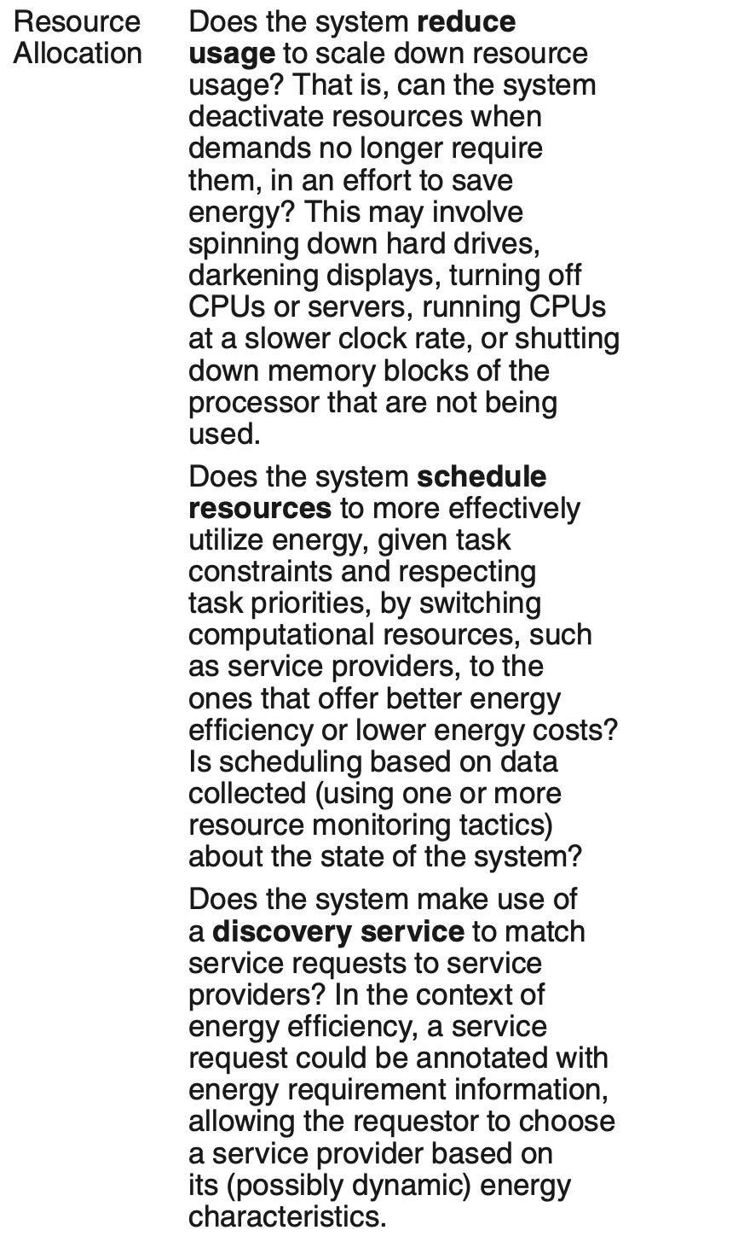
Tactics-Based Questionnaire for Energy Efficiency

Slide 17
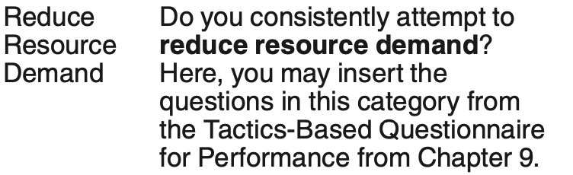
Tactics-Based Questionnaire for Energy Efficiency

Slide 18
Sensor Fusion Pattern for Energy Efficiency
Mobile apps and IoT systems often collect data from their environment using multiple sensors. In this pattern, data from low-power sensors can be used to infer whether data needs to be collected from higher-power sensors.
A common example in the mobile phone context is using accelerometer data to assess if the user has moved and, if so, to update the GPS location.

Slide 19
Sensor Fusion Pattern Benefits
Benefits:
The obvious benefit of this pattern is the ability to minimize the usage of more energy-intensive devices in an intelligent way rather than, for example, just reducing the frequency of sampling.

Slide 20
Sensor Fusion Pattern Tradeoffs
Tradeoffs:
Consulting and comparing multiple sensors adds up-front complexity.
The higher-energy-consuming sensor will provide higher-quality data, albeit at the cost of increased power consumption. And it will provide this data more quickly, since using the more energy-intensive sensor alone takes less time than first consulting a secondary sensor.
If the inference frequently results in accessing the higher-power sensor, this pattern could result in overall higher energy usage.

Slide 21
Kill Abnormal Tasks Pattern for Energy Efficiency
Mobile systems, because they are often executing apps of unknown provenance, may end up unknowingly running some exceptionally power-hungry apps.
This pattern provides a way to monitor the energy usage of such apps and to interrupt or kill energy-greedy operations.

Slide 22
Kill Abnormal Tasks Pattern Benefits
This pattern provides a “fail-safe” option for managing the energy consumption of apps with unknown energy properties.

Slide 23
Kill Abnormal Tasks Pattern Tradeoffs
Any monitoring process adds a small amount of overhead to system operations, which may affect performance and, to a small extent, energy usage.
The usability of this pattern needs to be considered. Killing energy-hungry tasks may be counter to the user’s intention.

Slide 24
Power Monitor Pattern for Energy Efficiency
The power monitor pattern monitors and manages system devices, minimizing the time during which they are active.
This pattern attempts to automatically disable devices and interfaces that are not being actively used by the application.

Slide 25
Power Monitor Pattern Benefits
This pattern can allow for intelligent savings of power at little to no impact to the end user, assuming that the devices being shut down are truly not needed.

Slide 26
Power Monitor Pattern Tradeoffs
Once a device has been switched off, switching it on adds some latency before it can respond, as compared with keeping it continually running. And, in some cases, the startup may be more energy expensive than a certain period of steady-state operation.
The power monitor needs to have knowledge of each device and its energy consumption characteristics, which adds up-front complexity to the design.

Slide 27
Summary
Energy Efficiency is a relatively new QA for architects to manage.
But it can be managed in exactly the same way that we manage any other QA—by properly specifying energy scenarios, by paying attention to energy properties, and by designing with patterns and tactics.

